Slide 1
[171212]논문스터디
김서진

Slide 2
Don’t let RAID Raid the lifetime of your SSD Array (HotStorage’13)
Motivation
- RAID5 could be less endurable because of parity protection.
Solution
- Analytical model show that RAID5 is less reliable than RAID0 with a small number of devices because of write amplification
Evaluation

Slide 3
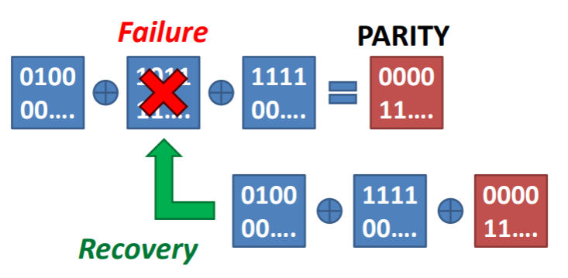
Parity Protection
Def. Protect a device array from a device failure
- Protect each page group from a page error
Parity = XOR of ALL data
Parity update results in additional writes

Slide 4
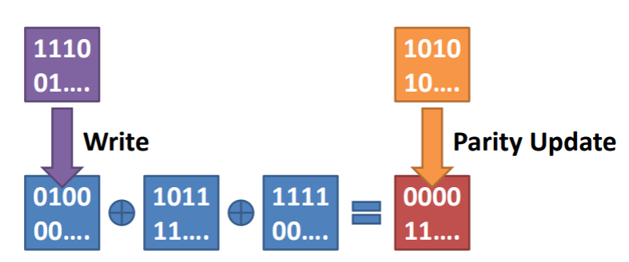
Parity protection
Parity update -> additional write
For a small write , Write amplification:2
For a large write, write amplification: N/(N-1)
(N is the number of SSDs in RAID)

Slide 5
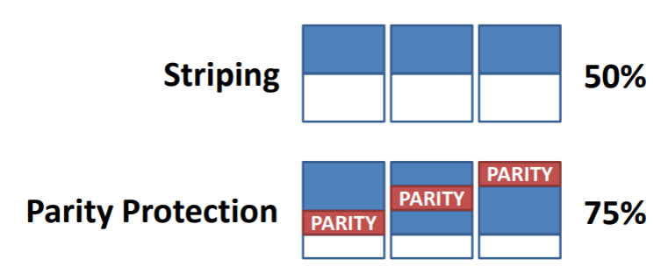
Parity protection
2. Parity increase space utilization
- less efficient garbage collection
- more write amplification
decrease the lifetime of SSDs

Slide 6
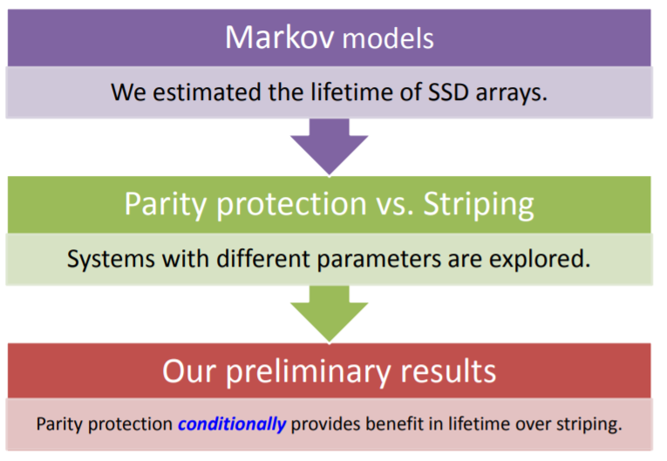
Lifetime model

Slide 7
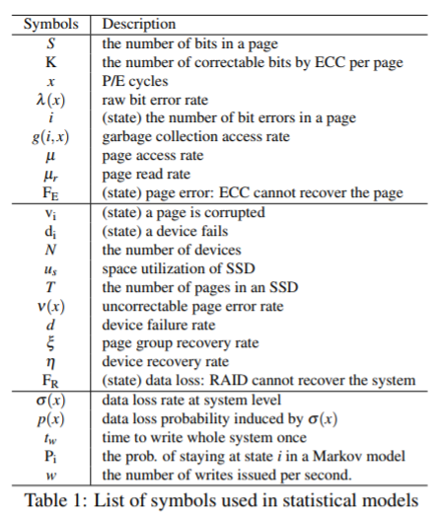
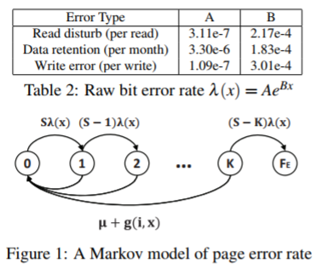
Markov model
Analyze single SSD’s reliability and device level protection
Page Error Rate Model at x write count
Bit errors accumulate until access time
ECC detects / corrects the bit error

Slide 8
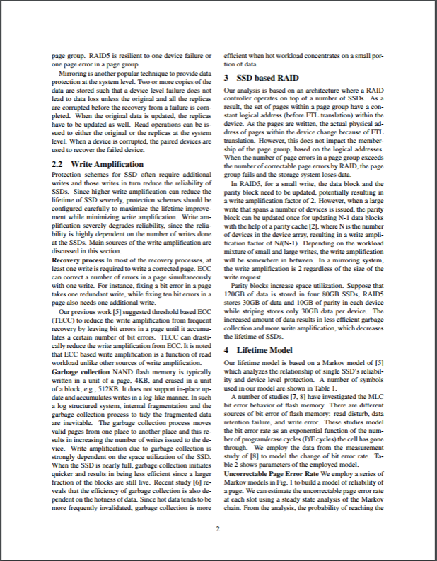
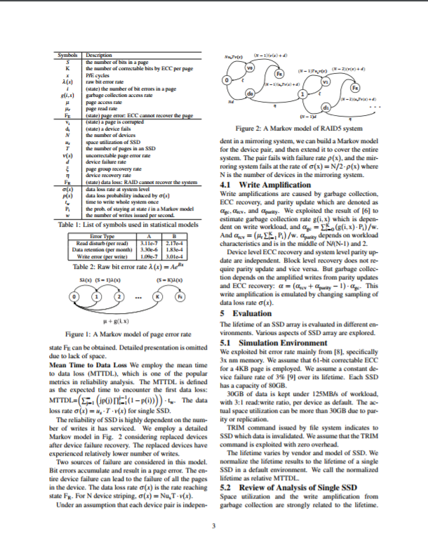
논문 page 2~3p

